Slide 1
Z
Z
Z
Z
Taking care of myself:
getting a good night’s sleep
Play this slideshow from beginning

Slide 2
We are learning about the importance of good sleep
We will be able to:
explain why sleep is important for a healthy lifestyle
describe bedtime routines that help improve sleep
identify how our sleep patterns and needs might change as we grow up

Slide 3
Sleep: What’s our starting point?
Draw a person getting ready for a good night’s sleep — what might they be doing, thinking, feeling?
Can you draw and write about:
How this person will feel when they wake up?
Anything that is helping them to sleep well?
Anything that might make it hard for them to sleep well?
Once you’ve finished your picture, put it to one side — you will come back to this later!

Slide 4
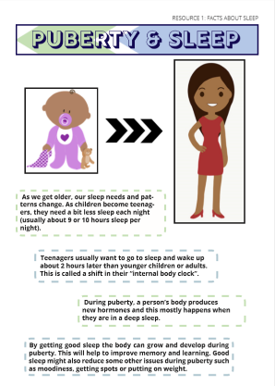
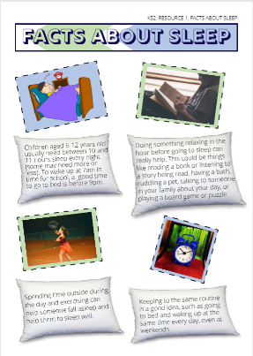
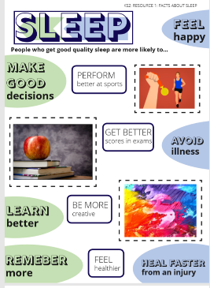
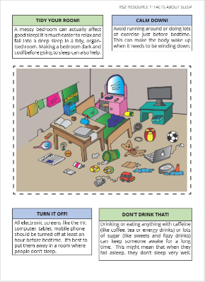
Activity 1: Why is sleep important?
?
?
Go on a fact hunt…
Look at the information on the posters in your worksheet pack (pages 1-4).
Use these posters to help you to answer the questions on the worksheet (My Sleep Factfile – page 5)
?
?
Could you now tell someone at home the 3 facts you think are most important?
?
?

Slide 5
Activity 1: Answers
Once you have completed your table, click on each box to reveal a possible answer…
QUESTION | POSSIBLE ANSWERS
How much sleep do children need each night? | Children between the ages of 6 and 12 usually need around 10-11 hours of sleep a night and should usually go to bed before 9pm.
Find 3 things to start doing that help someone get good sleep: | Relaxing, calming activities before bed, such as reading, meditating, etc. Exercising outside during the day, keeping to the same routine, tidy their bedroom.
Find 3 things to stop doing that would help someone sleep: | Running around before bed (or rough play). Using electronics, game consoles, including phones, tablets, TV and computer (ideally these should not be in the bedroom at all). Drinking fizzy drinks or ‘energy drinks’ (which may keep us awake and make it difficult to fall asleep when we want to), eating sugary foods (which may make us feel hungry or thirsty not long after eating them).
Why is it important to get good sleep? | It helps us to feel awake the next day and ready for school. We can find it easier to learn, have ideas for our school work, remember things we need to do (homework!), catch less colds and coughs, heal more quickly from injuries, perform well in tests and at sporting activities and feel well and happy.

Slide 6
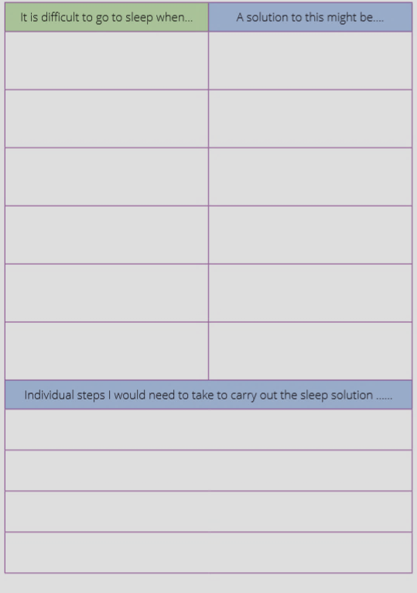
Activity 2: Sleepbusters
Complete the sleep buster solutions grid (page 6) by coming up with some possible solutions to the problems people might have when trying to go to sleep.
Can you think of any additional problems and solutions? Add them to the table.
Check your answers on the next slide…

Slide 7
Activity 2: Solutions
What instructions could you give somebody to help them carry out their solutions?
E.g. They could create a bedtime schedule to follow, so that they know when to turn off the TV etc.
It is difficult to go to sleep when… | A solution to this might be….
Someone has been watching TV, or playing games online before bed | Turning off all electronic screens like the TV, computer, tablet, mobile phone at least an hour before bedtime.
Someone is nervous or worried about something, e.g. a test at school | Do something relaxing before bed, e.g. reading a book, cuddling a pet, listening to a story
Someone drinks a sugary drink, such as orange juice or hot chocolate, before bed | Avoid drinking anything sugary and with caffeine in it before bed
Individual steps I would need to take to carry out the sleep solution ……

Slide 8
Sleep: Where are we now?
Go back to the ‘What’s our starting point?’ activity
Use a different colour pen or pencil to change your draw and write…
Is there anything you would like to change about your pictures?
Is there anything you would like to add to your pictures?
Can you think of one thing that you could change about your bedtime routine to help you to get better sleep?

Slide 9
Remember…
Finding it hard to get to sleep or not wanting to get up in the morning are all typical experiences as part of growing up. Many adults can sometimes find it hard too. It can sometimes happen when people feel worried or feel stressed about something.
The ChildLine website also has advice about sleep for young people:
www.childline.org.uk
Click here to discover Childline’s 8 tips for better sleep!
If you’re worried about your sleep, you should always speak to your parent or a trusted adult so they can help you.

Slide 10
More activities
Sleep story
Write a short story about a character who is struggling to get a good night’s sleep. Include advice for others about how they solved the problem.
Give me 10
Create a poster of 10 top tips for a good night’s sleep that you can share with your family and friends.
10 TOP TIPS

